Slide 1

Pocket Chef

Slide 2


Target Users
Users that these requirements could potentially originate from:
An older demographic is expected to use our app more

Slide 3
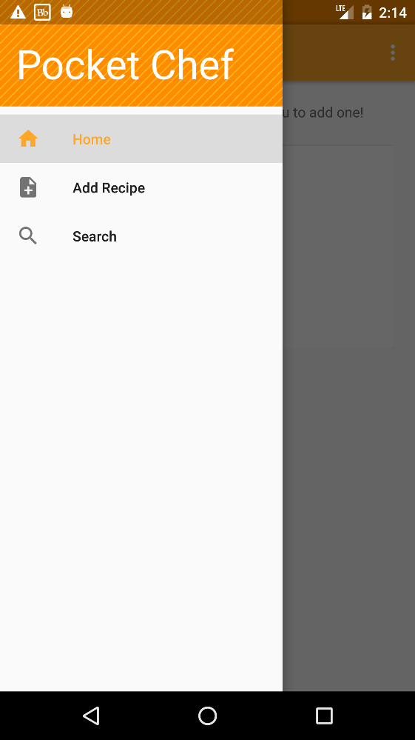

User Requirement
The Pocket Chef app shall hold and easily display recipes entered by the user

Slide 4
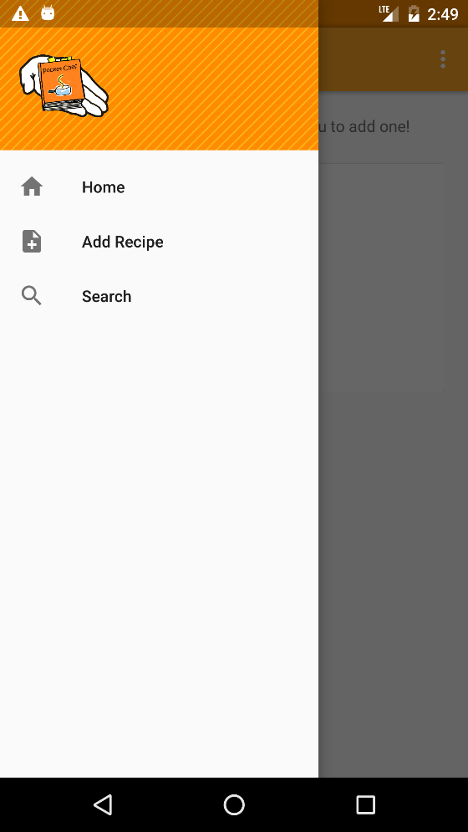
Minimum System Requirement
User should be able to add recipes to the app, including ingredients, steps to follow, and pictures of the final recipes

Slide 5

Minimum System Requirement
User should be able to clearly view the entire contents of a previously added recipe

Slide 6
System Requirement
User should be able to edit and delete recipes

Slide 7
System Requirement
User should be able to search for individual recipes by name of recipe

Slide 8

System Requirement
User should be able to back up stored recipes and retrieve recipes in case of data loss

Slide 9
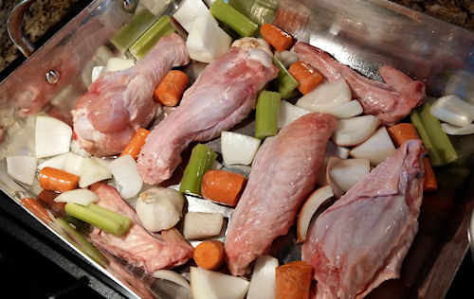
System Requirement
User should be able to perform an advanced search by category of food and ingredients used

Slide 10
System Requirement
User should be able to depend on the quick performance of the app (to improve productivity)

